Slide 1
Bioavailability and Bioequivalence
General concepts and overview

Slide 2

WHAT IS IT???
WHY IS IT???
HOW IS IT???
REGULATION VERSUS PHARMACEUTICAL COMP.

Slide 3
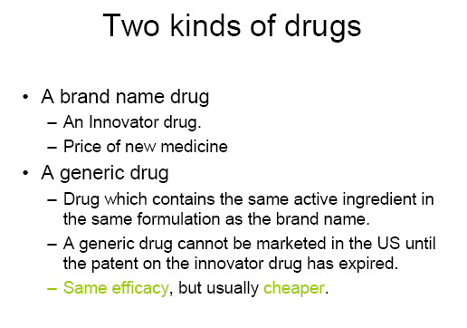

Slide 4
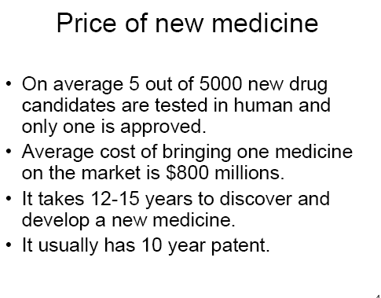

Slide 5
Generic Drug product: Definition
Same active ingredient (s)
Same strength
Same dosage form
Same route of administration
Same indications

Slide 6
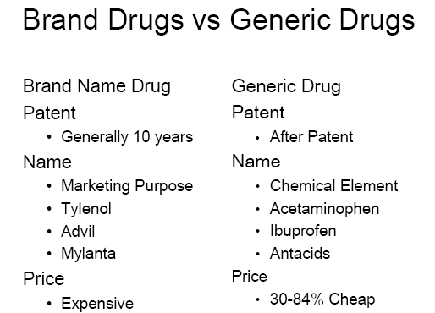

Slide 7
NDA vs. ANDA Review Process
Generic Drug
ANDA Requirements
Chemistry
Manufacturing
Controls
Labeling
Testing
Bioequivalence Study (In Vivo, In vitro)
Original Drug
NDA Requirements
Chemistry
Manufacturing
Controls
Labeling
Testing
Animal Studies
Clinical Studies
(Bioavailability)
Note: Generic drug applications are termed "abbreviated" because they are generally
not required to include preclinical (animal) and clinical (human) data to establish safety and effectiveness.
Instead, generic applicants must scientifically demonstrate that their product is bioequivalent
(i.e., performs in the same manner as the origina; drug).

Slide 8
FDA Definitions Used in Bioequivalence Determinations
Notes:
ACCESS Medical Group, Ltd.
S304 Bioequivalence rev08
10/6/03

Slide 9
FDA Determinations of Bioequivalence
Main Terms
Pharmaceutical equivalents
Pharmaceutical alternatives
Therapeutic equivalents
Bioavailability
Bioequivalence
Approved Drug Products With Therapeutic Equivalence Evaluations. 23rd ed. 2003. FDA/CDER Web site. Available at: http://www.fda.gov/cder/ob/docs/preface/ecpreface.htm#Therapeutic Equivalence-Related Terms. Accessed September 29, 2003.
Notes:
ACCESS Medical Group, Ltd.
S304 Bioequivalence rev08
10/6/03
FDA Determinations of Bioequivalence. Main Terms.
The Orange Book defines 5 terms that describe the most important concepts for discussing product substitution.¹ These terms are:
Pharmaceutical equivalents
Pharmaceutical alternatives
Therapeutic equivalents
Bioequivalence
Bioavailability
Reference
1. Approved Drug Products With Therapeutic Equivalence Evaluations. 23rd ed. 2003. FDA/CDER Web site. Available at: http://www.fda.gov/cder/ob/docs/preface/ecpreface.htm#Therapeutic Equivalence-Related Terms. Accessed September 29, 2003.

Slide 10
Pharmaceutical Equivalents
Drug products are considered pharmaceutical equivalents if they contain the same active ingredient(s), have the same dosage form and route of administration, and are identical in strength or concentration
Equivalent products contain the same amount of ingredient in the same dosage form but may differ in characteristics, such as shape, release mechanisms, and packaging
Approved Drug Products With Therapeutic Equivalence Evaluations. 23rd ed. 2003. FDA/CDER Web site. Available at: http://www.fda.gov/cder/ob/docs/preface/ecpreface.htm. Accessed September 29, 2003.
Notes:
ACCESS Medical Group, Ltd.
S304 Bioequivalence rev08
10/6/03
Pharmaceutical Equivalents.
The FDA considers 2 drug products pharmaceutical equivalents if they contain the same active ingredient(s), have the same dosage form and route of administration, and are identical in strength or concentration.¹
Pharmaceutically equivalent drug products are formulated to contain the same amount of active ingredient in the same dosage form and to meet the same or other applicable standards (eg, strength, quality, purity, and identity). However, these drug products may differ in characteristics, such as shape, release mechanisms, and packaging.
Reference
1. Approved Drug Products With Therapeutic Equivalence Evaluations. 23rd ed. 2003. FDA/CDER Web site. Available at: http://www.fda.gov/cder/ob/docs/preface/ecpreface.htm. Accessed September 29, 2003.

Slide 11
Pharmaceutical Alternatives
Drug products are considered pharmaceutical alternatives if they contain the same therapeutic moiety, are different salts, esters, or complexes of the same moiety, are different dosage forms, or are different strengths
Other pharmaceutical alternatives
  Different dosage forms and strengths within a single product line by a single manufacturer
  Extended-release formulations when compared with immediate- or standard-release formulations
Approved Drug Products With Therapeutic Equivalence Evaluations. 23rd ed. 2003. FDA/CDER Web site. Available at: http://www.fda.gov/cder/ob/docs/preface/ecpreface.htm#Therapeutic Equivalence-Related Terms. Accessed September 29, 2003.
Notes:
ACCESS Medical Group, Ltd.
S304 Bioequivalence rev08
10/6/03
Pharmaceutical Alternatives.
The FDA considers 2 products to be pharmaceutical alternatives if they contain the same therapeutic moiety, but are different salts, esters, or complexes of that moiety, or if they have different dosages or strengths, such as quinidine sulfate 200-mg tablets versus quinidine sulfate 200-mg capsules. Other products considered to be pharmaceutical alternatives include different dosage forms and strengths within a product line by a single manufacturer, and extended-release (ER) products when compared with immediate- or standard-release formulations of the same active ingredient.¹
Reference
1. Approved Drug Products With Therapeutic Equivalence Evaluations. 23rd ed. 2003. FDA/CDER Web site. Available at: http://www.fda.gov/cder/ob/docs/preface/ecpreface.htm#Therapeutic Equivalence-Related Terms. Accessed September 29, 2003.

Slide 12
Therapeutic Equivalents
Drug products are considered therapeutic equivalents if they are all of the following
  Pharmaceutical equivalents
  Bioequivalent
  Approved as safe and effective
  Adequately labeled
  Manufactured in compliance with current Good Manufacturing Practice regulations
Therapeutic equivalents are expected to have the same clinical effect and safety profile
Approved Drug Products With Therapeutic Equivalence Evaluations. 23rd ed. 2003. FDA/CDER Web site. Available at: http://www.fda.gov/cder/ob/docs/preface/ecpreface.htm#Therapeutic Equivalence-Related Terms. Accessed September 29, 2003.
Notes:
ACCESS Medical Group, Ltd.
S304 Bioequivalence rev08
10/6/03
Therapeutic Equivalents.
Drug products are considered therapeutic equivalents if they meet the following criteria:¹
They are approved as safe and effective and are pharmaceutical equivalents;
They are bioequivalent in that
They do not present a known or potential bioequivalence problem, and they meet an acceptable in vitro standard, or
If they do present such a known or potential problem, they are shown to meet an appropriate bioequivalence standard
They are adequately labeled and are manufactured in compliance with Current Good Manufacturing Practice regulations
Drugs marketed before 1938 and drugs marketed between 1938 and 1962 that are safe but not approved are excluded from FDA evaluations. When administered under conditions specified in the product label, therapeutic equivalents are expected to have the same clinical effect and safety profile.
Reference
1. Approved Drug Products With Therapeutic Equivalence Evaluations. 23rd ed. 2003. FDA/CDER Web site. Available at: http://www.fda.gov/cder/ob/docs/preface/ecpreface.htm#Therapeutic Equivalence-Related Terms. Accessed September 29, 2003.

Slide 13
Bioavailability
(quantifies ABSORPTION = ?, Reasons for poor F)
The extent and rate at which its active moiety is delivered from pharmaceutical form and becomes available in the systemic circulation
Pharmacokinetics
conc. vs time
Conc.(mg/L)
0.0
0
25
Time (h)

Slide 14
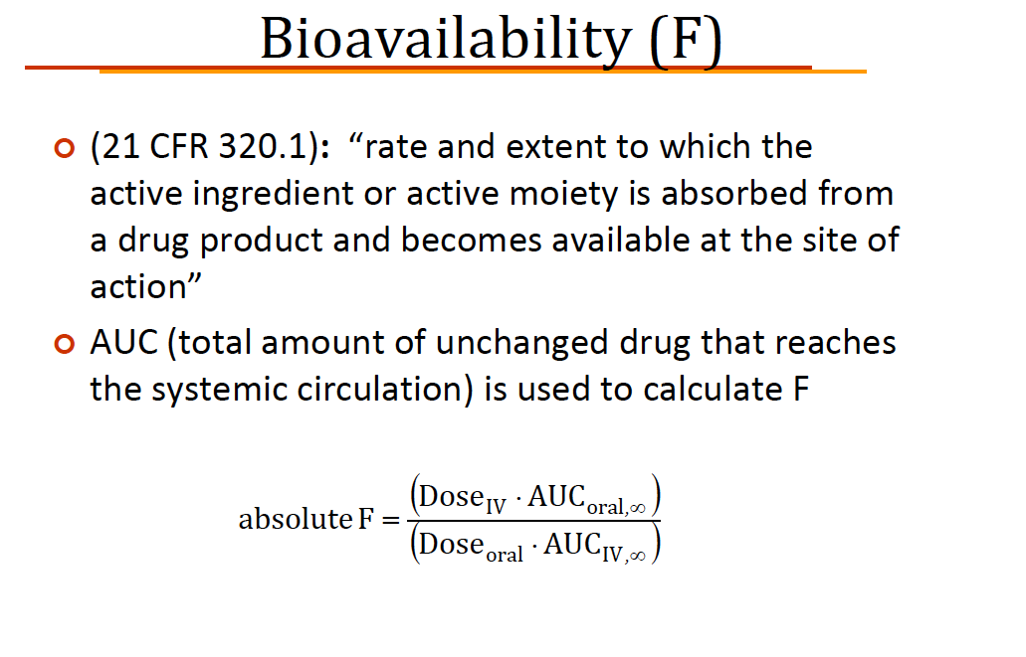
Official Definition

Slide 15
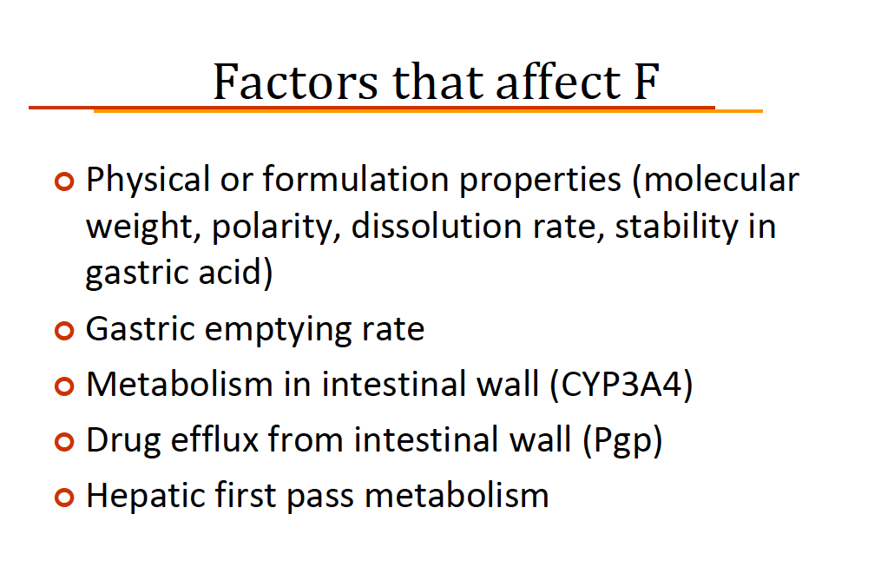

Slide 16
Why do we care about BIOAVAILABILITY?
The “true dose” is not the drug swallowed;
BUT is the drug available to exert its effect.
􀂄 Dissolution
􀂄 Absorption
􀂄 Survive metabolism
May have a drug with very low bioavailability
􀂄 Dosage form or drug may not dissolve readily
􀂄 Drug may not be readily pass across biological
membranes (i.e. be absorbed)
􀂄 Drug may be extensively metabolized during
absorption process (first-pass, gut wall, liver)
Important component of overall variability
􀂄 Variable bioavailability may produce variable exposure

Slide 17
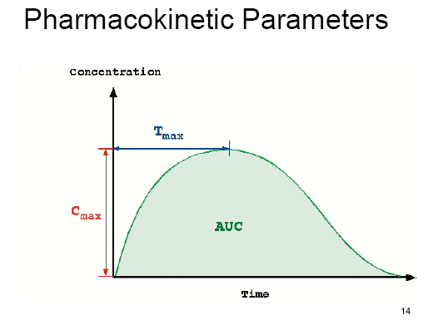

Slide 18
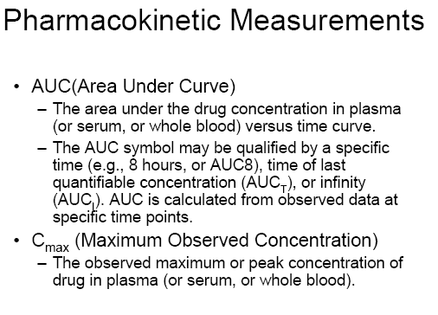

Slide 19
Rate versus Extent of Absorption
Extent of absorption is reflected by AUC
Rate of absorption, ka, is reflected by Tmax
Both Rate and Extent of absorption affect Cmax
Leads to 4 possible relative scenarios:
􀂄 (R) Rapid, (E) Complete Absorption
yields a short Tmax, high Cmax, high AUC
􀂄 (R) Rapid, (E) incomplete absorption
yields a short Tmax, low Cmax, low AUC
􀂄 (R) Slow, (E) complete absorption
yields a long Tmax, high Cmax, high AUC
􀂄 (R) Slow, (E) incomplete absorption
yields a long Tmax, low Cmax, low AUC

Slide 20
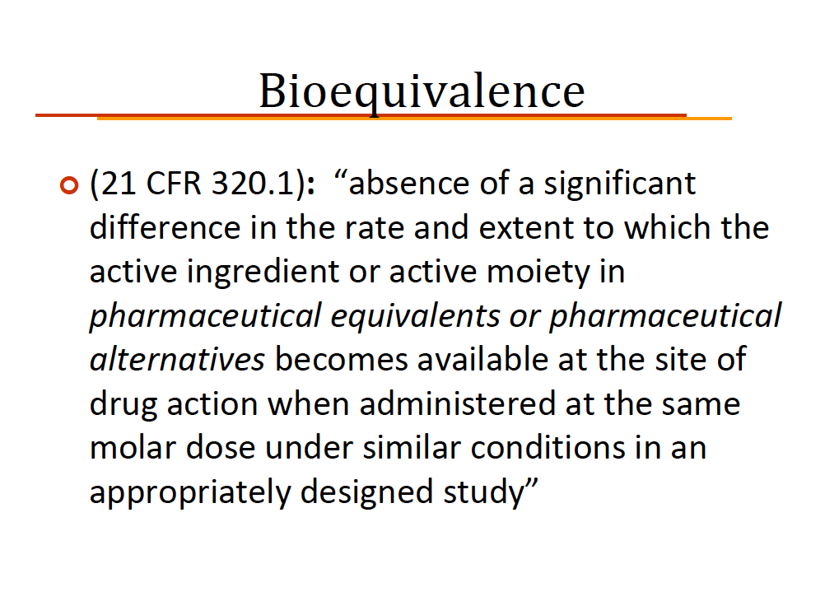

Slide 21
WHEN BE STUDIES ARE NECESSARY AND TYPES OF STUDIES REQUIRED
In vivo studies
Oral immediate release drug formulations
Non-oral and non-parentral drug formulations designed to act systemic absorption
Sustained or modified release drug formulation.
Fixed dose combination with systemic action.
Non solution ph. Products which are for non systemic use with out systemic absorption

Slide 22
In Vitro studies
  Drug for which applicant provides the data
    Highest dose strength is soluble at 250ml pH 1-7.5
    90% is absorbed orally
    As per IP
  Different strength of the drug manufactured by the same manufacturer
When bioequivalence studies are not necessary
  Parenterally administered drug
  New drug in solution for oral, does not contain excipient that produce GIT irritation.
  Drug is gas
  New drug is powder and is reconstitution and follow above points
  New drug is inhalation and no new devices is used for the inhalation.

Slide 23
DESIGN AND CONDUCT OF STUDIES
Pharmacokinetic Studies
  Study design
    Scientific questions to be answered
    Nature of the reference drug
    Availability of analytical method
    Design in a manner that formulation effect can distinguished
  Study population
  Selection of the number of subjects
    Possible withdrawals or drop outs
    At least 16 justified for ethical reasons
  Selection criteria for subjects
      Minimize intra and inter individual variation
      Healthy adults
      Risk of women of child bearing potential
      Elder patient of age 60 years
      Risk of toxicity studies have to be carried out in patients
  Genetic Phenotyping
    Design the protocol to favour of Indian population

Slide 24
  Study conditions
    Standardisation of environment usually diet, fluid intake, post dosing postures, exercise, sampling schedule.
    Selection of blood sampling points
    Fasting and fed state considerations
    Steady state studies
  Characteristic to be investigated during BE studies
    Concentration of the drug is too low to accurately measure in the biological matrix
    Limitation of analytical method
    Unstable drugs
    Drugs with short half lives
    Prodrug
    Racemates

Slide 25
Bioanalytical methodology
  Bioanalytical methods to determine the drug in plasma, serum, blood or urine etc
    Pre study Phase: actual start of studies & validation of method on biological matrix
    Study Phase: Validated bioanalytical method is applied to the actual analysis of samples from BE
    Quality control samples: samples with known concentration is prepared.
    Repeat Analysis: due to processing error, equipment failure.
  Statistical Evaluation
    Data analysis
    Statistical analysis

Slide 26
  Criteria for BE studies
    90% confidence Interval for AUC and C max
    Tighter limits for permissible differences for drugs
      Narrow therapeutic index
      Serious dose related toxicity
      Step dose curve
      Non linear pharmacokinectics.
    Wider limits for sound clinical justification
  Deviation from the study plan
    Drop outs
    Special considerations for modified release drug products
      Delayed release
      Sustained release
      Mixed immediate release and sustained release
      Mixed delayed and sustained release
      Mixed immediate and delayed release

Slide 27
  Study parameters
    Different with active ingredient
  Study design
    Dose and Fed state/ fasting state
  Requirements for modified release formulations unlikely to accumulate
    Modified release product is first marketed of that type dosage from the reference product should be immediate release formulation.
    If second compare with the same product for BE
  Requirements for modified release formulations likely to accumulate
    Single dose and steady dose of modified release formulation should compare with immediate release

Slide 28
PHARMACODYNAMIC STUDIES
Studies in healthy volunteers or patients for parameter to establish equivalence between two products
Studies necessary if analysis of the drug in plasma or urine is not sufficient accuracy and sensitive
COMPARATIVE CLINICAL STUDIES
If plasma concentration is not suitable to asses equivalence
Comparative clinical studies for orally administered drug concentration
Outline what other methods were tried and why unsuitable in the final report of BE
In Vitro studies
As per IP

Slide 29
DOCUMENTATION
Clinical Data
Details of the analytical method validation
Analytical data of volunteer plasma samples
Raw data
All comments of the chief investigator regarding the data of the study submitted for review
A copy of final report

Slide 30
Facilities for conducting BE studies
Legal identity
Impartiality, Confidentiality and integrity
Organisation and management
Documentation and Standard operating procedures
Clinical pharmacological unit

Slide 31
Maintenance of records for BE studies
  At least 2 years after the expiration date of the drug
Retention of BE samples
  All samples used in BE studies should be retained by organization carrying out the BE studies for 3 years or after 1 year of expiry of drug.
Special topics
  Food effect bioavailability studies
  Long half life drugs
  Early exposure
  Individual and population bioequivalence

Slide 32
BIOAVAILABILITY STUDIES
Route Bioavailability (%) Characteristics
Intravenous 100 (by definition) Most rapid onset
(IV)
Intramuscular 75 to ≤ 100 Large volumes often possible; may be
(IM) painful
Subcutaneous 75 to ≤ 100 Smaller volumes than IM; may be painful
(SC)
Oral (PO) 5 to < 100 Most convenient; first pass effects may be
significant
Rectal (PR) 30 to < 100 Less first-pass effects than oral
Inhalation 5 to < 100 Often very rapid onset
Transdermal 80 to ≤ 100 Usually very slow absorption; used for
lack of first-pass effects; prolonged duration
of action

Slide 33
Single Dose versus Multiple Dose Studies
The dose to be administered for a bioavailability study is determined from preliminary clinical experiments.
Single dose bioavailability studies are very common. They are easy, offer less exposure to drugs and are less tedious.
Limitation: Difficult to predict the steady-state characteristics of a drug and inter-subject variability.
multiple dose study :
the bioavailability is determined at steady-state.
Better evaluation of a controlled-release formulation is possible.
Small inter-subject variability is observed,
Requires collection of fewer blood samples.
Limitations:
  Poor compliance by subjects.
  Greater exposure of subjects to the test drug, increasing the potential for adverse reactions.
In multiple dose study the drug should be administered for 5 to 6 elimination half-lives until the steady-state has been reached, before collecting the blood samples.

Slide 34
ASSESSMENT OF BIOAVAILABILITY
Pharmacokinetics method – This method is more practical and discriminative. Pharmacokinetic methods are of two types.
Determination of whole blood, plasma or serum concentration
Urinary excretion method
Pharmacodynamic methods:
Acute Pharmacologic Response Method : When bioavailability measurement by pharmacokinetic method is difficult, an acute pharmacologic effect such as effect on pupil diameter, heart rate or BP can be useful as an index of drug bioavailability.
Disadvantage: It tends to be complex, expensive, time-consuming and require a sensitive and quantitative measure of the desired response.
Therapeutic Response Method: Clinical response of the drug for which it is intended to be used is measured.
E.g.: heart rate, body temperature, blood sugar levels, and for anti-inflammatory drugs, reduction in inflammation is determined.
Drawbacks: quantification of observed response is too improper to allow for reasonable assessment of relative bioavailability between two dosage forms of the same drug.

Slide 35
A) The blood (or serum or plasma) concentration-time curve -
These are based on the assumption that there is a direct relationship between the concentration of drug in blood or plasma and the concentration of drug at the site of action.
If the drugs are given to the volunteers through iv dose, the blood samples should be withdraw after 5min. And the frequency of sampling should be 15min.
In case of one compartment open model – at elimination phase 3 points are required to describe he kE value.
In case of two compartmental model – 5 to 6 points are required to describe kE value.
If Oral dose is given – 3 points are required to describe ka value.

Slide 36
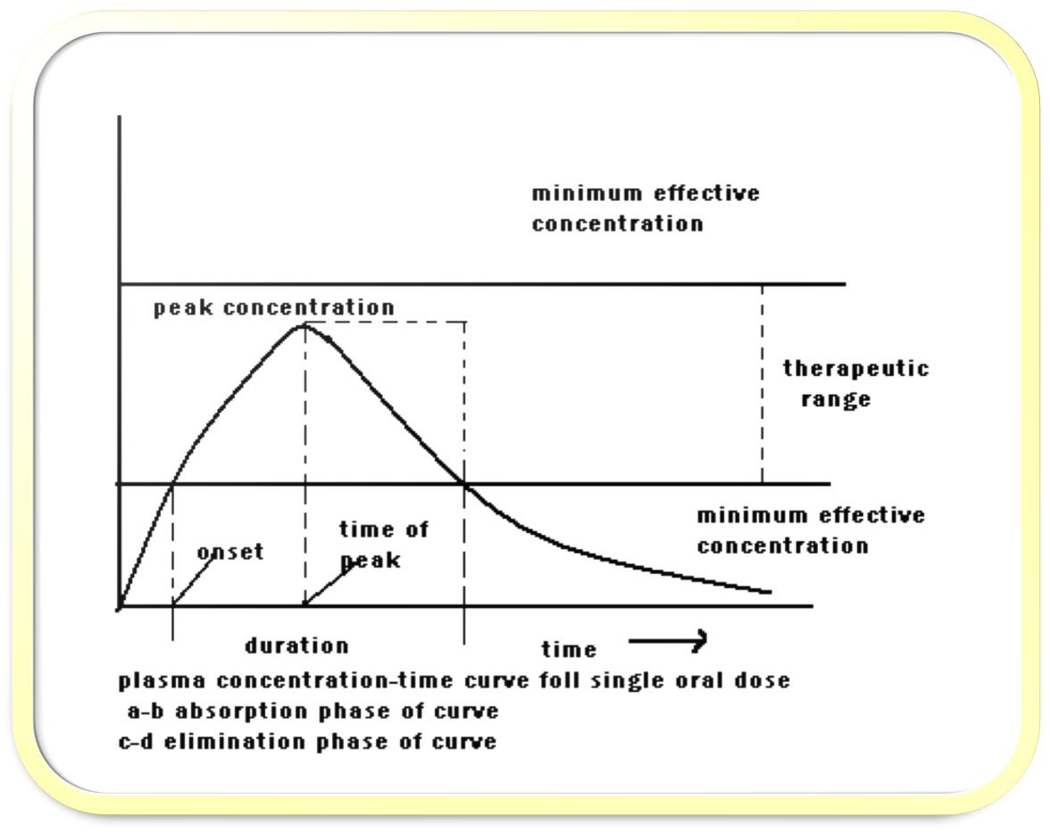
The key parameters for determining bioavailability

Slide 37
AUC: The AUC is proportional to the total amount of drug reaching the systemic circulation, and thus characterizes the extent of absorption.
Cmax: Gives indication whether drug is sufficiently absorbed systemically to provide a therapeutic response.
Tmax: The Tmax reflects the rate of drug absorption, and decreases as the absorption rate increases.
MEC: The minimum plasma concentration of the drug required to achieve a given pharmacological or therapeutic response
MSC: plasma concentration of the drug beyond which adverse effects are likely to happen.

Slide 38
THERAPEUTIC RANGE-The range of plasma drug concentration in which the desired response is achieved yet avoiding adverse effect. The aim is clinical practice is to maintain plasma drug concentration within the therapeutic range.
ONSET OF ACTION-On set of action is the time required to achieve the minimum effective plasma concentration following administration of drug formulation.
DURATION OF ACTION-Duration of action of the therapeutic effect of the drug is defined as the time period during which the plasma concentration of the drug exceeds the minimum effective level.
INTENSITY OF ACTION-In general, the difference between the peak plasma concentration and the minimum effective plasma concentration provides a relative measure of the intensity of the therapeutic response of the drug.

Slide 39
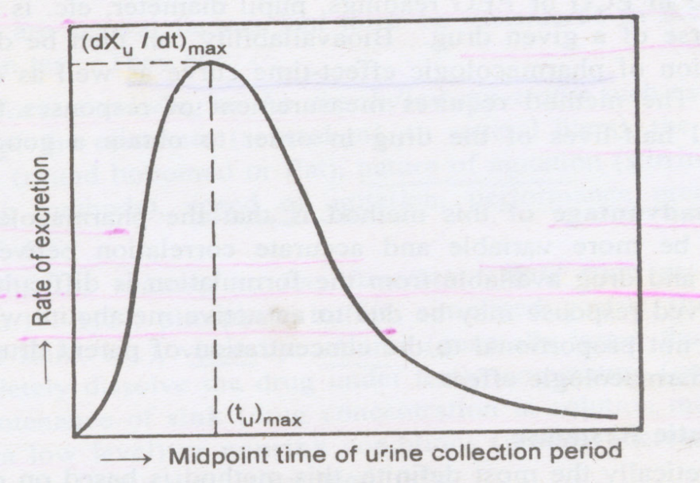
B) Urinary Excretion Data:
These studies are based on the principle that urinary excretion of the unchanged drug is directly proportional to the plasma concentration of total drug.
This technique of studying bioavailability is most useful for those drugs that are not extensively metabolized prior to urinary elimination.

Slide 40
The three major parameters examined in urinary excretion data are as follow:
1.(dXu/dt)max : maximum urinary excretion rate, gives the rate of appearance of drug in the urine is proportional to its concentration in systemic circulation. Its value increases as the rate of and/or extent of absorption increases
2. (tu)max : time for maximum excretion rate, is analogous to the of plasma level data, its value decreases as the absorption rate increases.
3. Xu : cumulative amount of drug excreted in the urine is related to the AUC of plasma level data and increases as the extent of absorption increases.
These studies used for certain thiazide diuretics and sulfonamides and for drugs that have urine as the site of action-for example, urinary antiseptics.

Slide 41
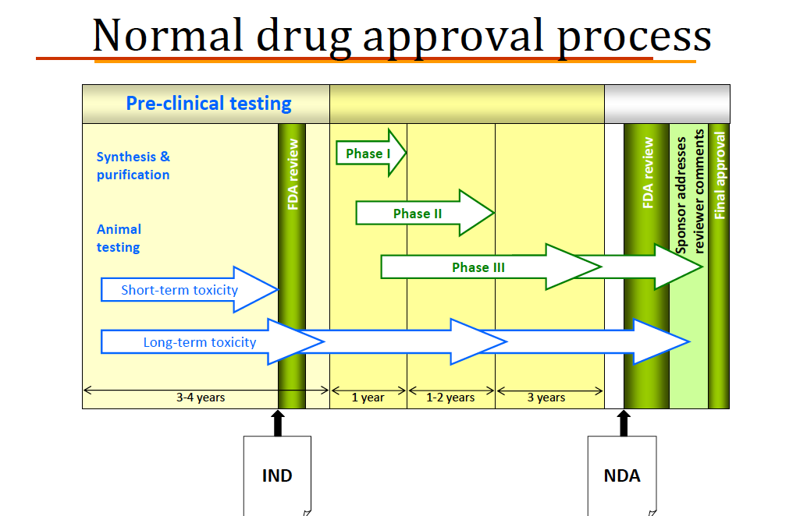
BIOEQUIVALENCE TESTING

Slide 42
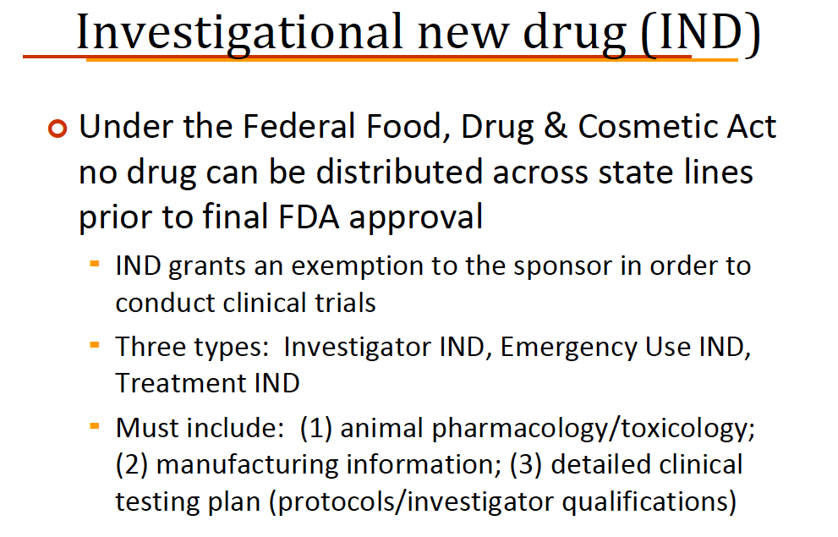

Slide 43
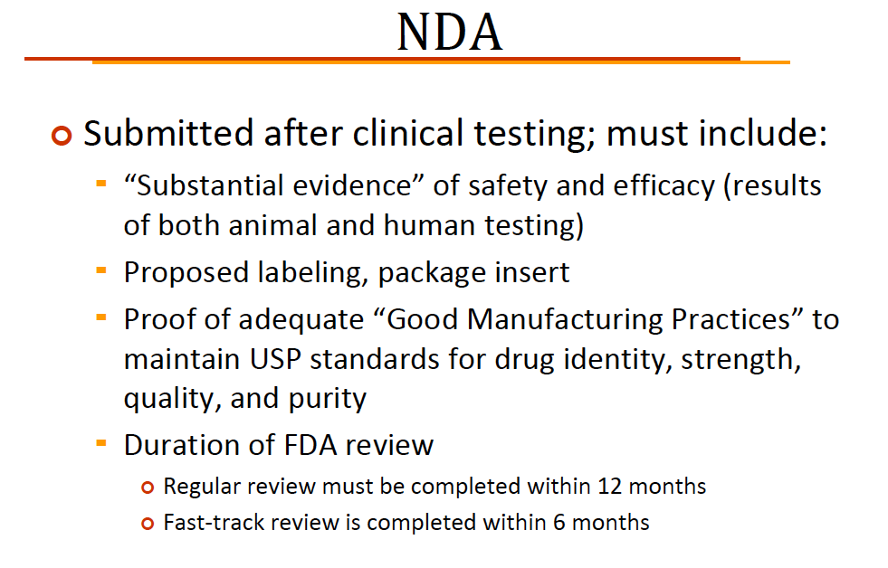

Slide 44
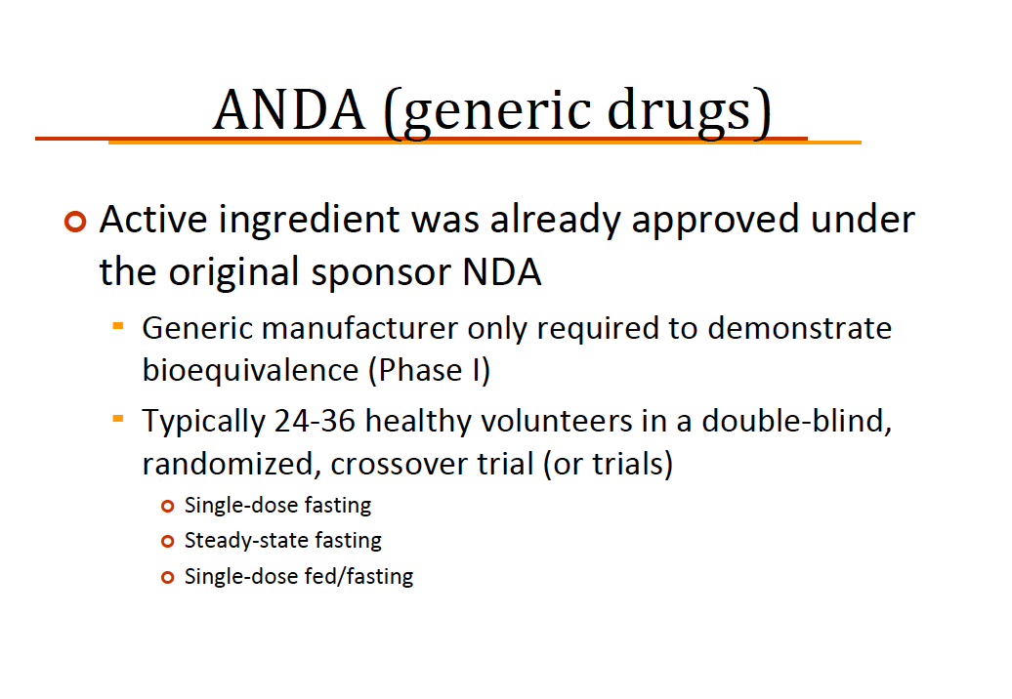

Slide 45
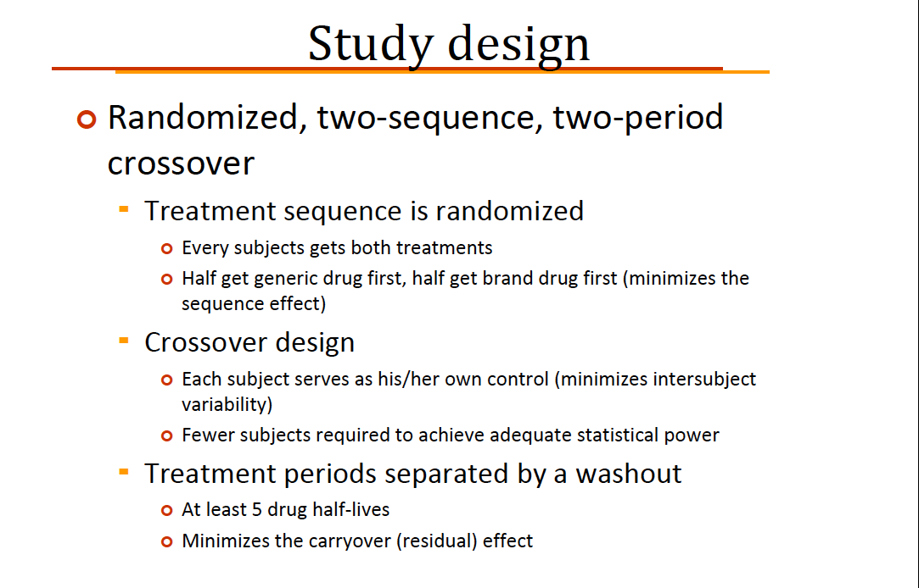

Slide 46
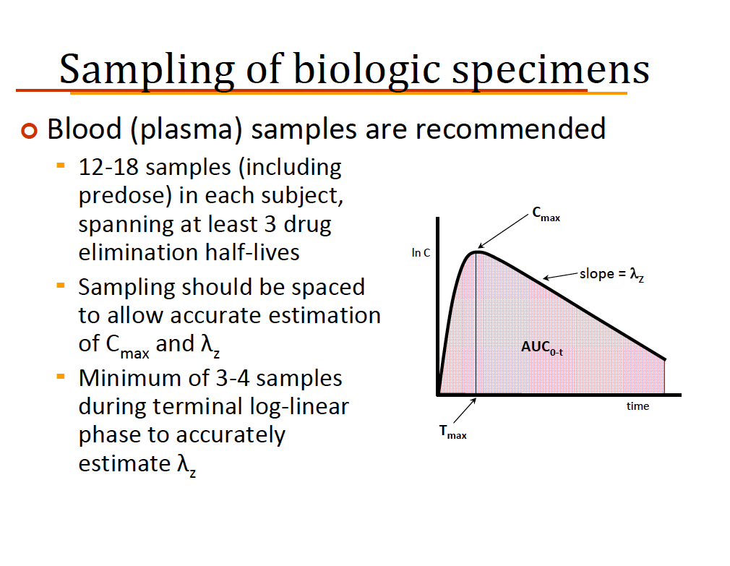

Slide 47
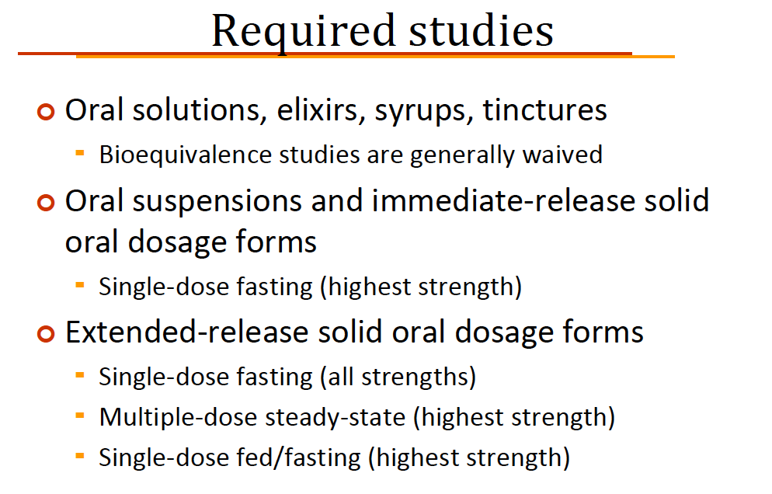

Slide 48
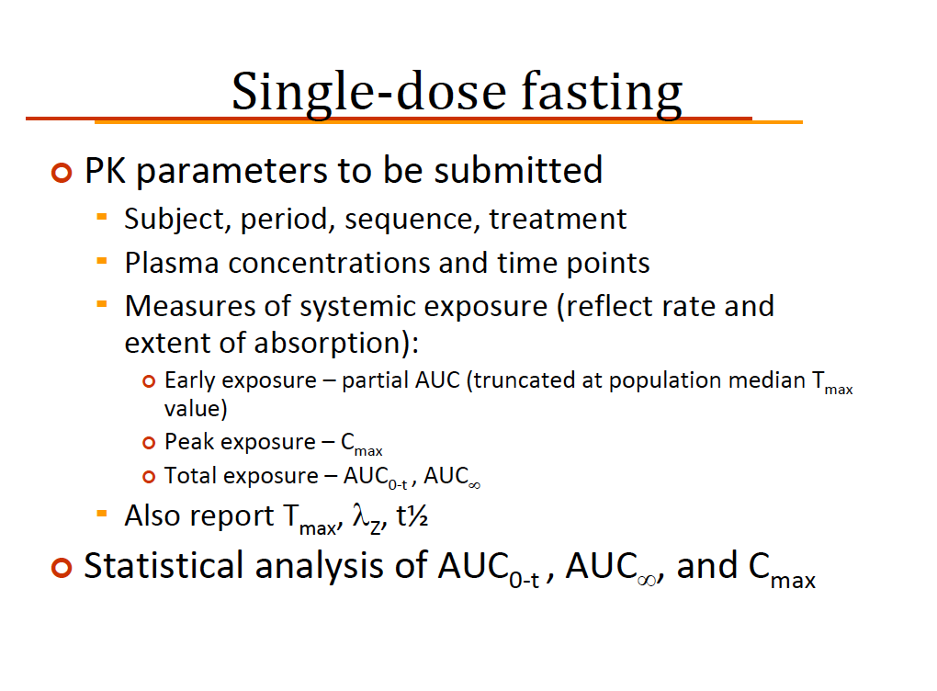

Slide 49
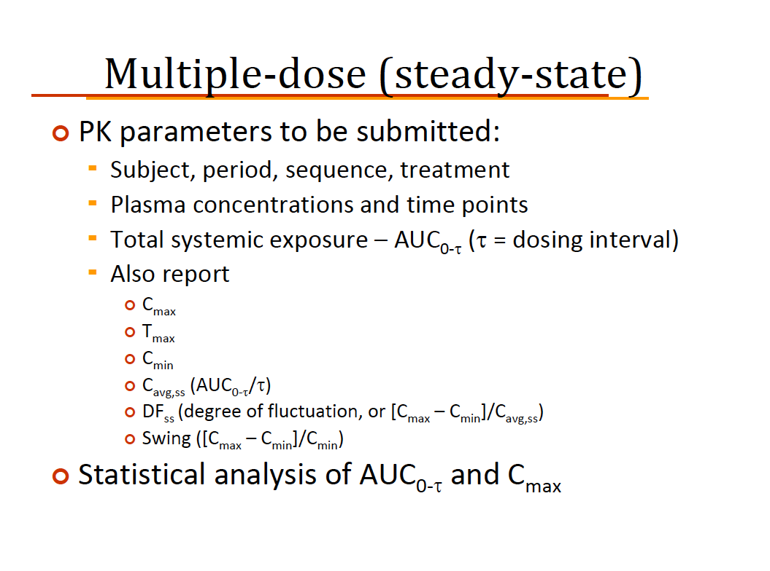

Slide 50
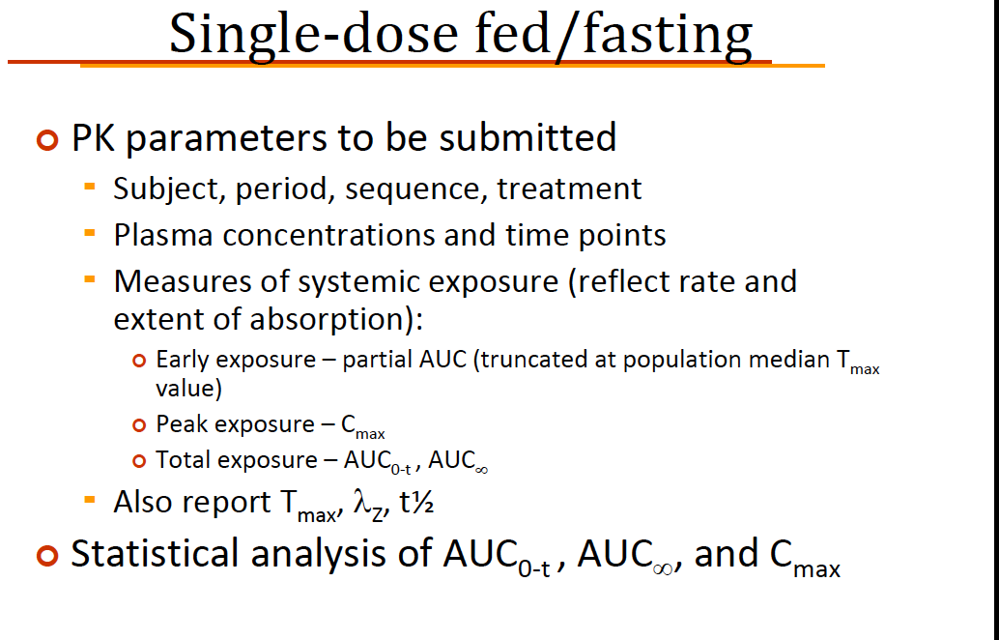

Slide 51
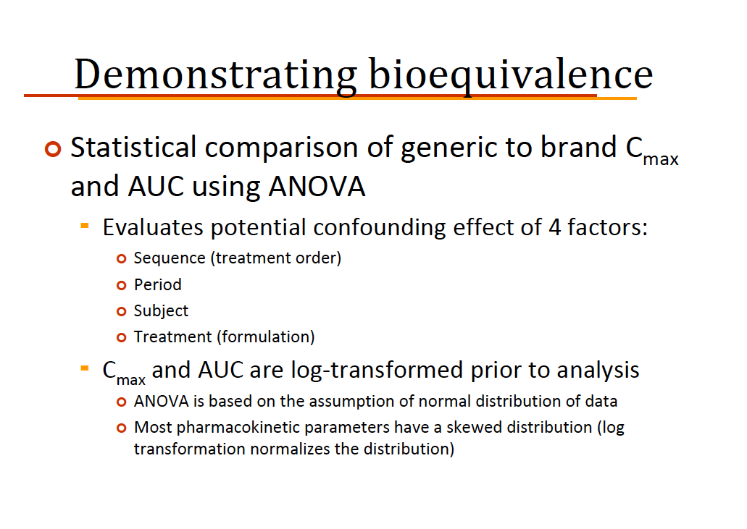

Slide 52
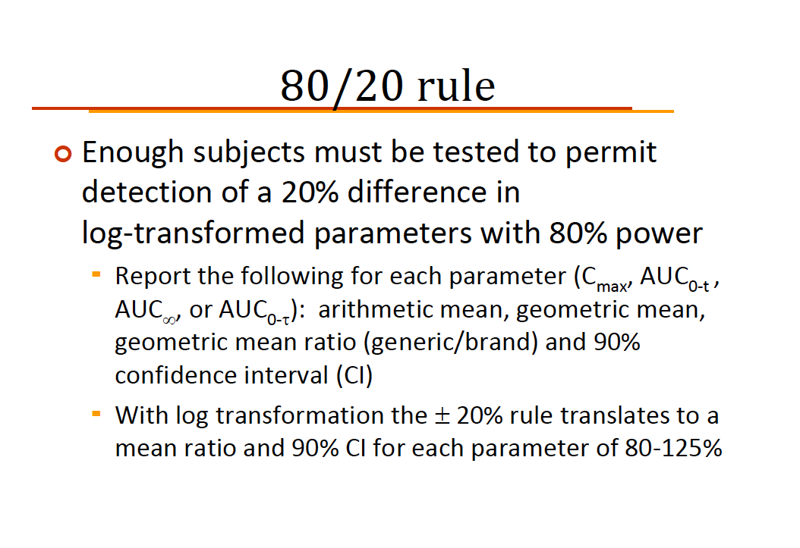

Slide 53
